Slide 1
Artificial Intelligence:
Course Organization
R. G. Mehta
Computer engineering Department, SVNIT, Surat, Gujarat, India

Slide 2
AI : An Introduction
Defination:
Artificial Intelligence is a branch of Science which deals with helping machines find solutions to complex problems in a more human-like fashion.
  This generally involves borrowing characteristics from human intelligence, and applying them as algorithms in a computer friendly way.
  A more or less flexible or efficient approach can be taken depending on the requirements established, which influences how artificial the intelligent behavior appears.
AI is generally associated with Computer Science, but it has many important links with other fields such as
  Maths, Psychology, Cognition, Biology and Philosophy, among many others.
  Our ability to combine knowledge from all these fields will ultimately benefit our progress in the quest of creating an intelligent artificial being.

Slide 3
Course Outline
Overview: Intelligent Systems and Applications
Artificial Intelligence (AI) Software Development Topics
  Knowledge representation
    Logical
    Probabilistic
  Search
    Problem solving by (heuristic) state space search
    Game tree search
  Planning: classical, universal
  Machine learning
    Models (decision trees, version spaces, ANNs, genetic programming)
    Applications: pattern recognition, planning, data mining and decision support
  Expert System
  Fuzzy Knowledge based system

Slide 4
Areas of AI and Some Dependencies
Knowledge Representation
Search
Logic
Machine Learning
Planning
Expert Systems
NLP
Vision
Robotics

Slide 5
What is Artificial Intelligence ?
making computers that think?
the automation of activities we associate with human thinking, like decision making, learning ... ?
the art of creating machines that perform functions that require intelligence when performed by people ?
the study of mental faculties through the use of computational models ?

Slide 6
What is Artificial Intelligence ?
the study of computations that make it possible to perceive, reason and act ?
a field of study that seeks to explain and emulate intelligent behaviour in terms of computational processes ?
a branch of computer science that is concerned with the automation of intelligent behaviour ?
anything in Computing Science that we don't yet know how to do properly ? (!)

Slide 7
What is Artificial Intelligence ?
THOUGHT
Systems that think
like humans
Systems that think
rationally
Systems that act
like humans
Systems that act
rationally
BEHAVIOUR
HUMAN
RATIONAL

Slide 8
Systems that act like humans:
Turing Test
“The art of creating machines that perform functions that require intelligence when performed by people.” (Kurzweil)
“The study of how to make computers do things at which, at the moment, people are better.” (Rich and Knight)

Slide 9

Systems that act like humans
?
You enter a room which has a computer terminal. You have a fixed period of time to type what you want into the terminal, and study the replies. At the other end of the line is either a human being or a computer system.
If it is a computer system, and at the end of the period you cannot reliably determine whether it is a system or a human, then the system is deemed to be intelligent.

Slide 10
Systems that act like humans
The Turing Test approach
  a human questioner cannot tell if
    there is a computer or a human answering his question, via teletype (remote communication)
  The computer must behave intelligently
Intelligent behavior
  to achieve human-level performance in all cognitive tasks

Slide 11
Systems that act like humans
These cognitive tasks include:
  Natural language processing
    for communication with human
  Knowledge representation
    to store information effectively & efficiently
  Automated reasoning
    to retrieve & answer questions using the stored information
  Machine learning
    to adapt to new circumstances

Slide 12
The total Turing Test
Includes two more issues:
  Computer vision
    to perceive objects (seeing)
  Robotics
    to move objects (acting)

Slide 13
What is Artificial Intelligence ?
THOUGHT
Systems that think
like humans
Systems that think
rationally
Systems that act
like humans
Systems that act
rationally
BEHAVIOUR
HUMAN
RATIONAL

Slide 14
Systems that think like humans: cognitive modeling
Humans as observed from ‘inside’
How do we know how humans think?
  Introspection vs. psychological experiments
Cognitive Science
  “The exciting new effort to make computers think … machines with minds in the full and literal sense” (Haugeland)
  “[The automation of] activities that we associate with human thinking, activities such as decision-making, problem solving, learning …” (Bellman)

Slide 15
What is Artificial Intelligence ?
THOUGHT
Systems that think
like humans
Systems that think
rationally
Systems that act
like humans
Systems that act
rationally
BEHAVIOUR
HUMAN
RATIONAL

Slide 16
Systems that think ‘rationally’
"laws of thought"
Humans are not always ‘rational’
Rational - defined in terms of logic?
Logic can’t express everything (e.g. uncertainty)
Logical approach is often not feasible in terms of computation time (needs ‘guidance’)
“The study of mental facilities through the use of computational models” (Charniak and McDermott)
“The study of the computations that make it possible to perceive, reason, and act” (Winston)

Slide 17
What is Artificial Intelligence ?
THOUGHT
Systems that think
like humans
Systems that think
rationally
Systems that act
like humans
Systems that act
rationally
BEHAVIOUR
HUMAN
RATIONAL

Slide 18
Systems that act rationally:
“Rational agent”
Rational behavior: doing the right thing
The right thing: that which is expected to maximize goal achievement, given the available information
Giving answers to questions is ‘acting’.
I don't care whether a system:
  replicates human thought processes
  makes the same decisions as humans
  uses purely logical reasoning

Slide 19
Systems that act rationally
Logic → only part of a rational agent, not all of rationality
  Sometimes logic cannot reason a correct conclusion
  At that time, some specific (in domain) human knowledge or information is used
Thus, it covers more generally different situations of problems
  Compensate the incorrectly reasoned conclusion

Slide 20
Systems that act rationally
Study AI as rational agent –
2 advantages:
  It is more general than using logic only
    Because: LOGIC + Domain knowledge
  It allows extension of the approach with more scientific methodologies

Slide 21
What is Artificial Intelligence (AI)?
Computational models of human behavior
  Programs that behave (externally) like humans
  Computational models of human “thought”
  Programs that operate (internally) the way humans do
  Computational systems that behave intelligently (Cognitive science)
    What does it mean to behave intelligently?
  Computational systems that behave rationally
    More on this later

Slide 22
Rational agents
Agent mean “something that acts.”
Or An agent is an entity that perceives and acts
  Agent is a piece of software that runs in the world and gathers information and takes action based on that information
E.g. Web agents that do things for you, or human publicity agents.
It could be anything
  A robot,
  a factory
  a web shopping program
  a traffic control system…
  Agent shorthand for computational agents that behave autonomously
Abstractly, an agent is a function from percept histories to actions:
[f: P* → A]

Slide 23
What is AI?
Artificial
  Produced by human art or effort, rather than originating naturally.
Intelligence
  is the ability to acquire knowledge and use it" [Pigford and Baur]
So AI was defined as:
  AI is the study of ideas that enable computers to be intelligent.
  AI is the part of computer science concerned with design of computer systems that exhibit human intelligence(From the Concise Oxford Dictionary)

Slide 24
From the above two definitions, we can see that AI has two major roles:
  Study the intelligent part concerned with humans.
  Represent those actions using computers.
    (Rational system, Rational Agents)

Slide 25
The Agent and the Environment
How do we begin to formalize the problem of building an agent?
  Make a dichotomy between the agent and its environment
  Not everyone believes that making this dichotomy is a good idea, but we need the leverage it gives us.
    Difficult to describe, “how an agent works by separating it from the world it works in, because the interface is so big and so complicated.”
    But we can define the whole system if interrelated agents

Slide 26
The Agent and the Environment
How do we begin to formalize the problem of building an agent?
  Make a dichotomy between the agent and its environment

Slide 27
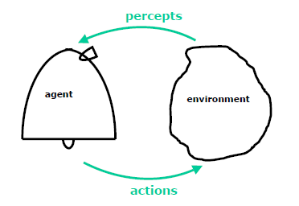
The Agent and the Environment
  E.g the a robot (Agent) and the world it lives in.
    It will take actions that affect the state of the environment
    It will receive percepts somehow that tell it about what's going on in the environment.
    There is a loop where the agent does something that changes the state of the environment, then it perceives some new information about the state of the environment.
    There's a hard question of where to draw the line between the agent and the environment.

Slide 28
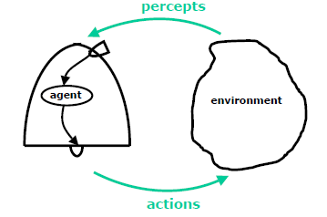
The Agent and the Environment
  Since we're going to be thinking about
    what is going on in the agent’s head and so the actions,
    instead of going from the body to the environment, actions are to be going from the agent's head to its wheels and the percepts are coming from the camera into its brain

Slide 29
The Agent and the Environment
The other way, agent is the software that runs some big hardware system.
E.g. A walking robot : Hardness of the job depends on the design of the hardware.
  walking robots, called "compass walkers",
    With just two legs hinged together and when you set them on an inclined plane they will walk down the hill (if you get it balanced right); so no need of any computation to do that walking.
    So, the computation, or intelligence or whatever, is in the design of the hardware.

Slide 30
The Agent and the Environment
The other way, agent is the software that runs some big hardware system.
E.g. A walking robot : Hardness of the job depends on the design of the hardware.
  walking robots, called "compass walkers",
    With just two legs hinged together and when you set them on an inclined plane they will walk down the hill (if you get it balanced right); so no need of any computation to do that walking.
    So, the computation, or intelligence or whatever, is in the design of the hardware.
  On the other hand, you could build a great big contraption,
    with six or eight legs that is taller than this room and it runs a whole complicated planning algorithm to decide where to place each foot.
    That's the opposite extreme of putting all the intelligence in the brain, instead of in the hardware.
How can we formalize a computational problem of building an agent?

Slide 31
The Agent and the Environment
How can we formalize a computational problem of building an agent?

Slide 32
World Model
What do we need to write down when we talk about the problem of making an agent? How can we specify it really carefully?

Slide 33
World Model
A – the action space
Need to design an action interface.
  For a;; things that the agent can do.
  The space of actions might contains some space of possible actions that the agent can take in the world. Which can be
    continuous,
    or it might be very high dimensional,

Slide 34
World Model
A – the action space
P – the percept space
2. A percept space
All the things that the agent can perceive in the world
These spaces can be continuous
  imagine that the agent can perceive “how high its arm is raised” or “the temperature in some reaction vessel”.
Normally the interaction between the agent and the environment is considered in discrete time, with a cycle taking place every one second or two seconds or ten seconds or minutes

Slide 35
World Model
A – the action space
P – the percept space
E – the environment: A* → P
3. The environment as being a mapping of strings of actions into percepts.
there's some history of actions done by an agent
and every time the agent does a new action
the environment generates a new percept

Slide 36
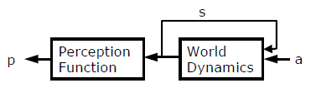
World Model
A – the action space
P – the percept space
E – the environment: A* → P
Alternatively,
Define S – internal state [may not be visible to agent]
Deception function: S→ P
World dynamics: S X A* → P
Think of the environment as having some internal state, which may not be visible to the agent.
The perception function says “what percepts the agent will receive as a function of the current state of the environment.”
The world dynamics or state transition function says what the next world state will be, given the previous world state and the action taken by the agent.

Slide 37
Agent Design
U – utility function: S→ R or (S* → R)
Now time to design the action of agent
what constitutes good or bad behavior of the agent in the environment.
Utility functions are typically thought of as a
  mapping from states in the world to real values,
  Or sequences of states into real values.
  "Agent, these are the states of the world and this is how valuable they are from your perspective." So that indirectly tells the agent what you want it to do.

Slide 38
Agent Design
U – utility function: S→ R or (S* → R)
The agent design problem: Find P* → A
  mapping of sequences of percepts to actions
  maximizes the utility of the resulting sequence of states (each action maps from one state to next state).

Slide 39

Vacuum-cleaner world
Percepts: location and contents, e.g., [A,Dirty]
Actions: Left, Right, Suck, NoOp

Slide 40
A vacuum-cleaner agent
\input{tables/vacuum-agent-function-table}

Slide 41
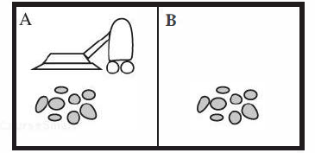
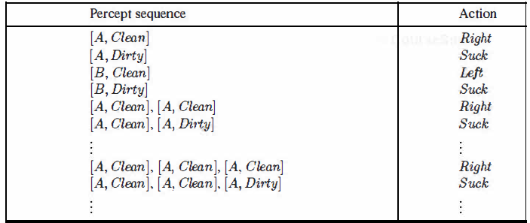
Intelligent Agents
A vacuum-cleaner world with just two locations.
Partial tabulation of a simple agent function for the vacuum-cleaner world

Slide 42
Rational agents
An agent should strive to "do the right thing", based on what it can perceive and the actions it can perform. The right action is the one that will cause the agent to be most successful
Performance measure: An objective criterion for success of an agent's behavior
E.g., performance measure of a vacuum-cleaner agent could be amount of dirt cleaned up, amount of time taken, amount of electricity consumed, amount of noise generated, etc.

Slide 43
Rational agents
Rational Agent: For each possible percept sequence, a rational agent should select an action that is expected to maximize its performance measure, given the evidence provided by the percept sequence and whatever built-in knowledge the agent has.

Slide 44
Rational agents
Rationality is distinct from omniscience (all-knowing with infinite knowledge)
  A rational agent takes actions, it believes will . achieve its goals
    I don’t like to get wet, so I bring an umbrella. Is it rational?
    Depends on the weather forecast and whether I’ve heard If I’ve heard the forecast for rain (and I believe it) then bringing the umbrella is rational.
Rationality

Slide 45
A Generic
Intelligent Agent Model
Agent
Sensors
Internal Model (if any)
Observations
Knowledge about World
Predictions
Environment
Knowledge about Actions
Expected Rewards
Preferences
Action
Effectors
Monday, 24 Aug 2009
CIS 530 / 730: Artificial Intelligence

Slide 46
Rational agents
Agents can perform actions in order to modify future percepts so as to obtain useful information (information gathering, exploration)
An agent is autonomous if its behavior is determined by its own experience (with ability to learn and adapt)
Let's say that I don't like to be wet and so when I come out of my office in the morning, I bring an umbrella. Is that rational? Depends on the weather forecast, and whether I've heard the weather forecast. If I heard the weather forecast and I'm disposed to believe it, and I think it's going to rain, then it's rational to bring my umbrella. Whether it's going to rain or not, whether you think it's dumb for me to want to stay dry, given what I'm trying to do and given what I know, we'll say an action is rational, if it would lead to doing a good job of what I'm trying to do.

Slide 47
Rational agents
Rationality Vs omniscience
  Assume the most recent forecast is for rain but I did not listen to it and I did not bring my umbrella. Is that rational?
  Yes, since I did not know about the recent forecast!
  Rationality is not omniscience. For example, some time ago I rode my bike in to work, not knowing that it was going to snow like crazy and I was going to run into a car on the way home. You can still argue that it was rational for me to ride my bike, maybe at some grander level it was irrational not to have watched the weather forecast the night before. But, given what I knew it was ok to ride my bike, even though it turned out be dumb at some level, because I didn't know what was happening.

Slide 48
Rational agents
  Rationality Vs success
  Suppose the forecast is for no rain but I bring my umbrella and I use it to defend myself against an attack. Is that rational?
  No, although successful, it was done for the wrong reason.

Slide 49
Rational agents
  Rationality Vs success
  Rationality is not the same as success. Imagine that I take my umbrella, I know that it's nice and sunny out and I take the umbrella anyway, which seems to be irrational of me. But, then, I use the umbrella to fend off a rabid dog attack. You might say, well it was rational of her to take the umbrella because it saved her from the rabid dog. But that wouldn't be right because it was done for the wrong reason. Even though it was successful and useful; we would not have said that was rational. So this limits the scope of what we want our agents to do. They don't have to be successful and they don't have to know everything, they just have to do a good job given what they know and what they want.

Slide 50
Limited Rationality
There is a big problem with our definition of rationality…
The agent might not be able to compute the best action (subject to its beliefs and goals).
  So, we want to use limited rationality: “acting in the best way you can subject to the computational constraints that you have”
  Computation limitations for human brain seek for optimal solution
  The brain can give optimal solution in one circumstances but not in other.
  The agent behaves like our brain e.g. Chess player will not be good in crossing road, and the agent’s aggregate behavior is not rational.

Slide 51
Limited Rationality (Cont…)
Rationality in broader context :
  given all the things that you have to do,
  given all the circumstances that you're likely to be faced with in the environment that you’ve been put in,
  how can you respond best in the aggregate?
  Any individual response may not be the best response, even given your hardware, but it may still be that the program you're running is the best possible program when measured in aggregate over all the things that you have to do.

Slide 52
Limited Rationality
There is a big problem with our definition of rationality…
The agent might not be able to compute the best action (subject to its beliefs and goals).
(limited rational) agent design problem: Find P* → A
  mapping of sequences of percepts to actions
  maximizes the utility of the resulting sequence of states
  subject to our computational constraints
  Given the specification of an environment, we want to find the best possible mapping from P* to A (sequences of percepts to actions) that, subject to our computational constraints, does the best job it can as measured by our utility function.

Slide 53
Issues
How could we possibly specify completely the domain the agent is going to work in?
  If you expect a problem to be solved, you have to say what the problem is!
  Specification is usually iterative: Build agent, test, modify specification
It is hard to specify the domain that the agent is going to work in?
Need to design iterative process

Slide 54
Issues
How could we possibly specify completely the domain the agent is going to work in?
  If you expect a problem to be solved, you have to say what the problem is!
  It is hard to specify the complete domain that the agent is going to work in?
  Specification is usually iterative: Build agent, test, modify specification
  Why isn’t this “just” software engineering?
  There is a huge gap between specification and the program
  E.g. Given all the pieces of the space shuttle and constraints on how they go together, to sit in a chair and write the program for the optimal solution is SE
  There is a huge gap between the specification for which agent work and the program you write to access and execute them.

Slide 55
Search
Search is the fundamental technique of AI.
  Possible answers, decisions or courses of action are structured into an abstract space, which we then search.
Search is either "blind" or “uninformed":
  blind
    we move through the space without worrying about what is coming next, but recognising the answer if we see it
  informed
    we guess what is ahead, and use that information to decide where to look next.
We may want to search for the first answer that satisfies our goal, or we may want to keep searching until we find the best answer.

Slide 56
Knowledge Representation & Reasoning
The second most important concept in AI
If we are going to act rationally in our environment, then we must have some way of describing that environment and drawing inferences from that representation.
  how do we describe what we know about the world ?
  how do we describe it concisely ?
  how do we describe it so that we can get hold of the right piece of knowledge when we need it ?
  how do we generate new pieces of knowledge ?
  how do we deal with uncertain knowledge ?

Slide 57
Knowledge
Declarative
Procedural
Declarative knowledge deals with factoid questions (what is the capital of India? Etc.)
Procedural knowledge deals with “How”
Procedural knowledge can be embedded in declarative knowledge

Slide 58
Planning
Given a set of goals, construct a sequence of actions that achieves those goals:
  often very large search space
  but most parts of the world are independent of most other parts
  often start with goals and connect them to actions
  no necessary connection between order of planning and order of execution
  what happens if the world changes as we execute the plan and/or our actions don’t produce the expected results?

Slide 59
Learning
If a system is going to act truly appropriately, then it must be able to change its actions in the light of experience:
  how do we generate new facts from old ?
  how do we generate new concepts ?
  how do we learn to distinguish different situations in new environments ?

Slide 60
Interacting with the Environment
In order to enable intelligent behaviour, we will have to interact with our environment.
Properly intelligent systems may be expected to:
  accept sensory input
    vision, sound, …
  interact with humans
    understand language, recognise speech,
    generate text, speech and graphics, …
  modify the environment
    robotics

Slide 61
History of AI
AI has a long history
  Ancient Greece
    Aristotle
  Historical Figures Contributed
    Ramon Lull
    Al Khowarazmi
    Leonardo da Vinci
    David Hume
    George Boole
    Charles Babbage
    John von Neuman
  As old as electronic computers themselves (c1940)

Slide 62

The ‘von Neuman’ Architecture

Slide 63
History of AI
Origins
  The Dartmouth conference: 1956
    John McCarthy (Stanford)
    Marvin Minsky (MIT)
    Herbert Simon (CMU)
    Allen Newell (CMU)
    Arthur Samuel (IBM)
The Turing Test (1950)
“Machines who Think”
  By Pamela McCorckindale

Slide 64
Periods in AI
Early period - 1950’s & 60’s
  Game playing
    brute force (calculate your way out)
  Theorem proving
    symbol manipulation
  Biological models
    neural nets
Symbolic application period - 70’s
  Early expert systems, use of knowledge
Commercial period - 80’s
  boom in knowledge/ rule bases

Slide 65
Periods in AI cont’d
? period - 90’s and New Millenium
Real-world applications, modelling, better evidence, use of theory, ......?
Topics: data mining, formal models, GA’s, fuzzy logic, agents, neural nets, autonomous systems
Applications
  visual recognition of traffic
  medical diagnosis
  directory enquiries
  power plant control
  automatic cars

Slide 66
Fashions in AI
Progress goes in stages, following funding booms and crises: Some examples:
1. Machine translation of languages
1950’s to 1966 - Syntactic translators
1966 - all US funding cancelled
1980 - commercial translators available
2. Neural Networks
1943 - first AI work by McCulloch & Pitts
1950’s & 60’s - Minsky’s book on “Perceptrons” stops nearly all work on nets
1986 - rediscovery of solutions leads to massive growth in neural nets research
The UK had its own funding freeze in 1973 when the Lighthill report reduced AI work severely -Lesson: Don’t claim too much for your discipline!!!!
Look for similar stop/go effects in fields like genetic algorithms and evolutionary computing. This is a very active modern area dating back to the work of Friedberg in 1958.

Slide 67
Symbolic and Sub-symbolic AI
Symbolic AI is concerned with describing and manipulating our knowledge of the world as explicit symbols, where these symbols have clear relationships to entities in the real world.
Sub-symbolic AI (e.g. neural-nets) is more concerned with obtaining the correct response to an input stimulus without ‘looking inside the box’ to see if parts of the mechanism can be associated with discrete real world objects.
This course is concerned with symbolic AI.

Slide 68
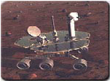
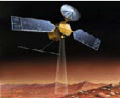
AI Applications
Autonomous Planning & Scheduling:
  Autonomous rovers.

Slide 69
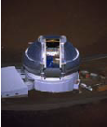

AI Applications
Autonomous Planning & Scheduling:
  Telescope scheduling

Slide 70


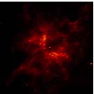
AI Applications
Autonomous Planning & Scheduling:
  Analysis of data:

Slide 71
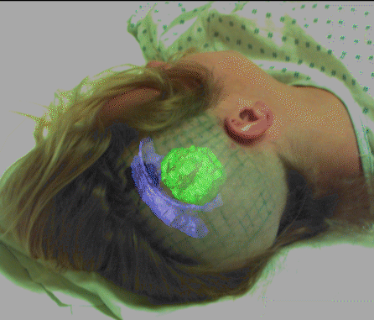

AI Applications
Medicine:
  Image guided surgery

Slide 72

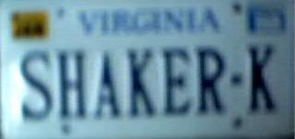


AI Applications
Medicine:
  Image analysis and enhancement

Slide 73

AI Applications
Transportation:
  Autonomous vehicle control:

Slide 74

AI Applications
Transportation:
  Pedestrian detection:

Slide 75
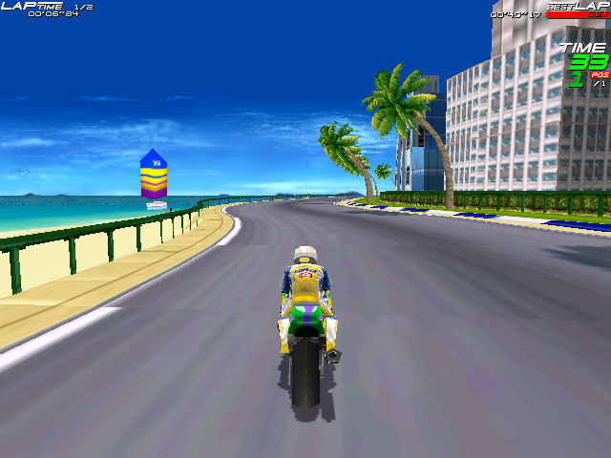
AI Applications
Games:

Slide 76
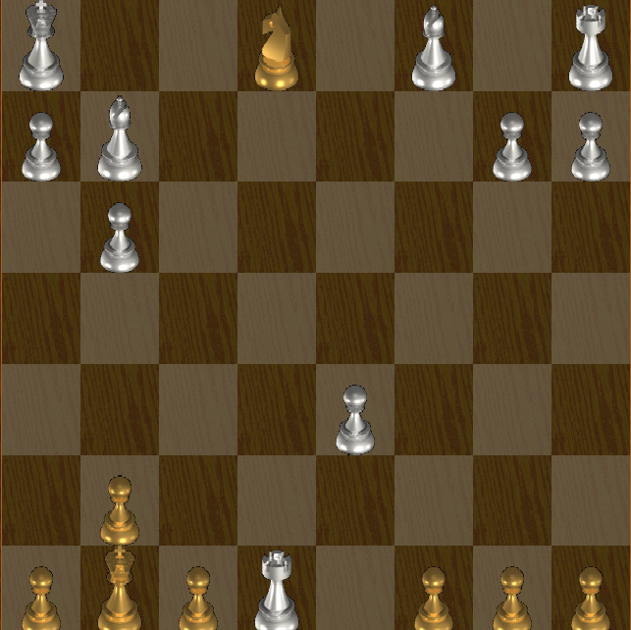
AI Applications
Games:

Slide 77

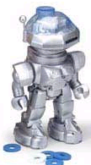
AI Applications
Robotic toys:

Slide 78
AI Applications
Other application areas:
Bioinformatics:
  Gene expression data analysis
  Prediction of protein structure
Text classification, document sorting:
  Web pages, e-mails
  Articles in the news
Video, image classification
Music composition, picture drawing
Natural Language Processing .
Perception.

Slide 79
Artificial Intelligence:
Some Problems and Methodologies
Problem Solving
  Classical search and planning
  Game-theoretic models
Making Decisions under Uncertainty
  Uncertain reasoning, decision support, decision-theoretic planning
  Probabilistic and logical knowledge representations
Pattern Classification and Analysis
  Pattern recognition and machine vision
  Connectionist models: artificial neural networks (ANNs), other graphical models
Data Mining and Knowledge Discovery in Databases (KDD)
  Framework for optimization and machine learning
  Soft computing: evolutionary algorithms, ANNs, probabilistic reasoning
Combining Symbolic and Numerical AI
  Role of knowledge and automated deduction
  Ramifications for cognitive science and computational sciences

Slide 80
Intelligent Agents:
Overview
Agent: Definition
  Any entity that perceives its environment through sensors and acts upon that environment through effectors
  Examples (class discussion): human, robotic, software agents
Perception
  Signal from environment
  May exceed sensory capacity
Sensors
  Acquires percepts
  Possible limitations
Action
  Attempts to affect environment
  Usually exceeds effector capacity
Effectors
  Transmits actions
  Possible limitations
Monday, 24 Aug 2009
CIS 530 / 730: Artificial Intelligence

